Slide 1

loop unrolling
code
Combining loop unrolling strategies and code predication to reduce the worst-case execution time of real-time software
predication
worst-case execution
time
real-time software
Sokratis Koseoglou

Slide 2

Loop Unrolling-Code Predication
Authors’ Optimization Approach
Motivational Example
Evaluation & Results

Slide 3

Worst-Case Execution Time (WCET)
Combining loop unrolling strategies and code predication to reduce the worst-case execution time of real-time software
Worst-Case Execution Time (WCET) is an important parameter for a Real-Time System
Time Analyzers are used in order to evaluate the WCET
Goal of this paper is to reduce the WCET of a real-time system
There are two ways to reduce the WCET
Faster Processor
Software Optimization
1

Slide 4
Loop Unrolling
Combining loop unrolling strategies and code predication to reduce the worst-case execution time of real-time software
Loops are frequently good targets for compiler optimizations
for(int i = 10; i != 0; i = i - 1){
a[i] = a[i] + b;
}
for(int i = 10; i != 0; i = i - 2){
a[i] = a[i] + b;
}
a[i - 1] = a[i - 1] + b
Loop Unrolling
Unrolling Factor = 1
LOOP: LW r2, 0(r1)
ADD r2, r2, r3
SW r2, 0(r1)
ADDI r1, r1, -4
BNE r1, r5, LOOP
LOOP: LW r2, 0(r1)
ADD r2, r2, r3
SW r2, 0(r1)
LW r2, -4(r1)
ADD r2, r2, r3
SW r2, -4(r1)
ADDI r1, r1, -8
BNE r1, r5, LOOP
5 Instr. x 10 Iter. = 50 Instructions
8 Instr. x 5 Iter. = 40 Instructions
2

Slide 5
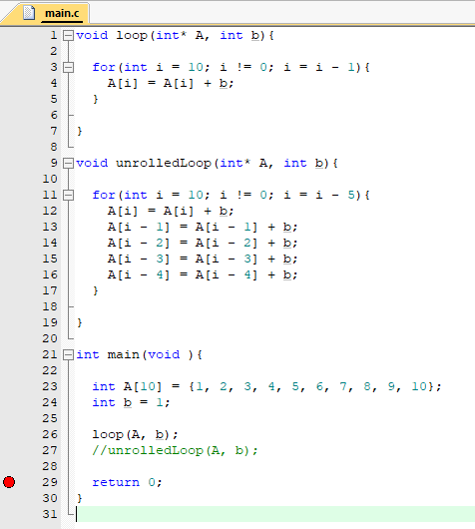
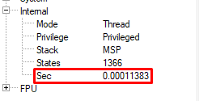
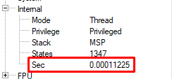
Loop Unrolling – keil μVision ARM Example
Combining loop unrolling strategies and code predication to reduce the worst-case execution time of real-time software
Demo Code for Loop Unrolling
Rolled Loop Time
Unrolled Loop Time
3

Slide 6
Branch Prediction vs Code Predication
Combining loop unrolling strategies and code predication to reduce the worst-case execution time of real-time software
Branch Prediction
Code Predication
Predict whether a branch is taken or not
Do work of both directions
Synchronous Architectures have about 90% Accuracy
Throw away instructions from the wrong path
No penalty if correct prediction
Waste up to 50%
Huge penalty if wrong prediction
Big if-else
Branch Prediction
Small if-else
Code Predication
If (f){
a++;
}else{
a--;
}
BEQ r1, 0, else
ADDI r2,r2,1
else:
ADDI r2,r2,-1
ADDI r2,r2,1
(not f) ADDI r2,r2,-1
4

Slide 7
Loop Unrolling-Code Predication
Motivational Example

Slide 8
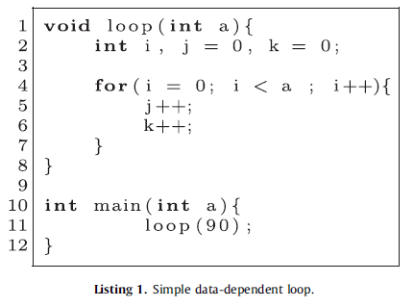
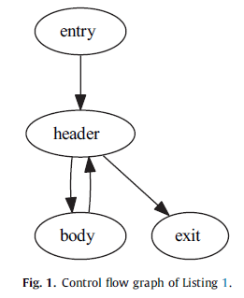
Motivational Example Loop
Combining loop unrolling strategies and code predication to reduce the worst-case execution time of real-time software
Data-Dependent Loop (since loop iterations variable is not static)
Compiler generated a Control Flow Graph (CFG)
A problem with Data-Dependent loops is the difficulty to choose an effective unrolling factor
We need to add exit conditions for each body replication
for(i = 0; i < a; i++)
(Header)
j++;
k++;
(Body)
5

Slide 9
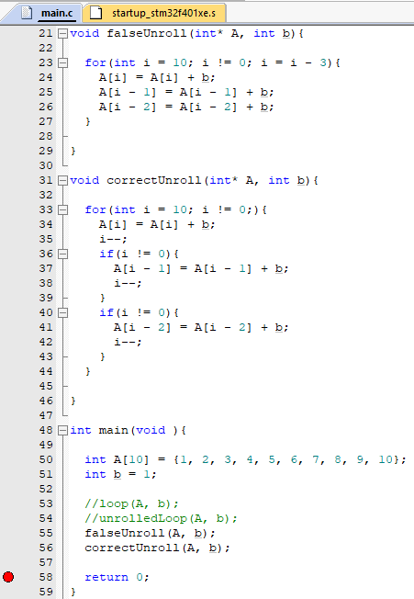
Loop Unrolling – keil μVision ARM Example
Combining loop unrolling strategies and code predication to reduce the worst-case execution time of real-time software
Demo Code for Loop Unrolling with exit conditions
6

Slide 10
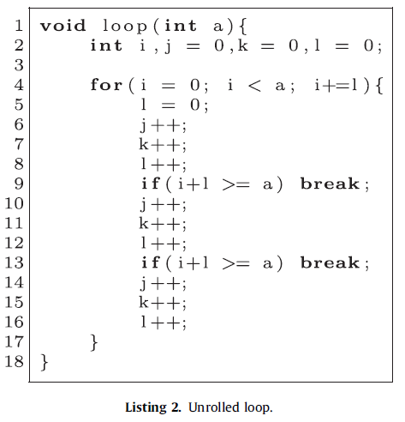
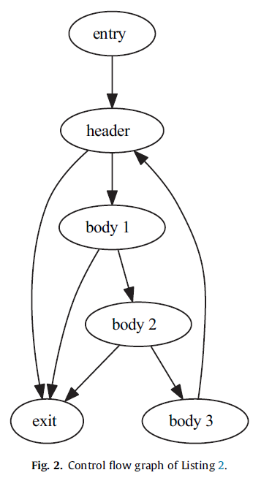
Motivational Example Loop
Combining loop unrolling strategies and code predication to reduce the worst-case execution time of real-time software
Note that, instructions increased
If the target architecture supports code predication, we can consider the following code, in which we are able to do if-conversion
7

Slide 11
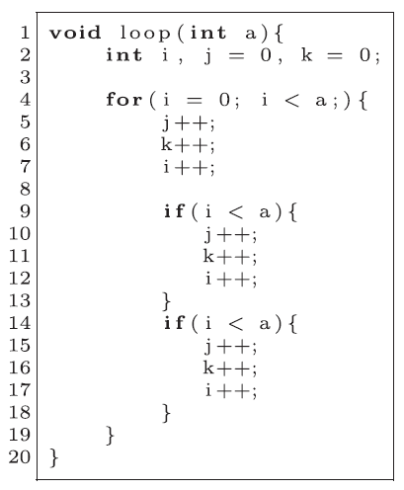
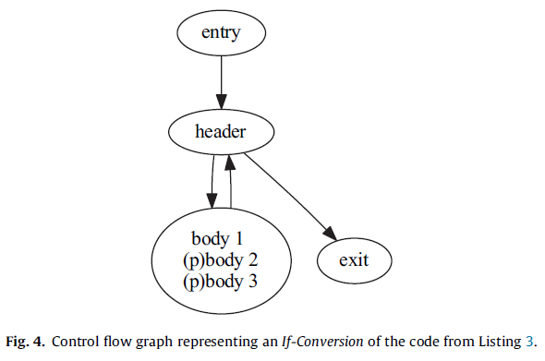
Motivational Example Loop
Combining loop unrolling strategies and code predication to reduce the worst-case execution time of real-time software
The prefix (p) means that the execution of blocks body2 and body3 are conditioned to some predication guard p
8

Slide 12
Loop Unrolling-Code Predication
Authors’ Optimization Approach
Motivational Example

Slide 13
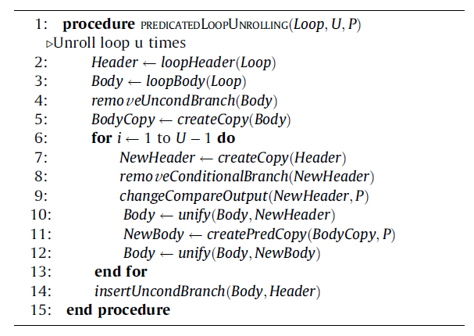
Predicated Loop Unrolling Algorithm
Combining loop unrolling strategies and code predication to reduce the worst-case execution time of real-time software
Identify Header & Body of the loop
Remove unconditional branch and place it in the end
Create a body copy which will be always executed
Create predicated body copies inside the for loop, with U iterations, where U is the unrolling factor
9

Slide 14
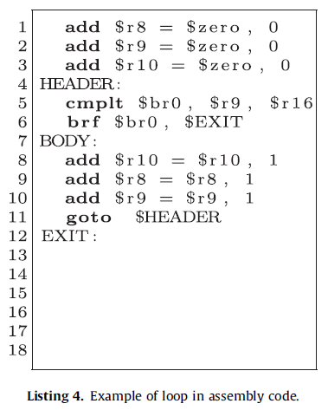
Example of our Approach
Combining loop unrolling strategies and code predication to reduce the worst-case execution time of real-time software
Assembly
10

Slide 15
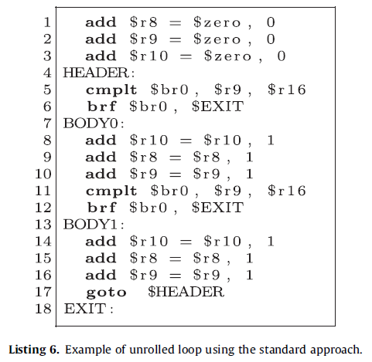
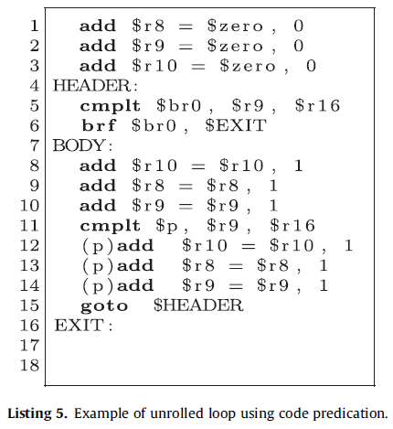
Example of our Approach
Combining loop unrolling strategies and code predication to reduce the worst-case execution time of real-time software
Standard Approach with branch for exit conditions
Predicated Approach
We can see that the predicated version has fewer instructions
11

Slide 16
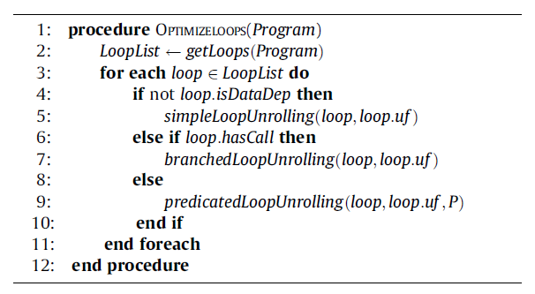
Optimization Choice Algorithm
Combining loop unrolling strategies and code predication to reduce the worst-case execution time of real-time software
Optimizations Algorithm that is executed by the compiler
Compiler runs this code for each loop that is in the WCEP
Standard (without branches)
Used for non-data dependent loops (with fixed executions counts)
Standard (with branches)
Used for data dependent loops that have call instructions in the body
Predicated
Used for data dependent loops that have simple bodies and do not use call instructions
12

Slide 17
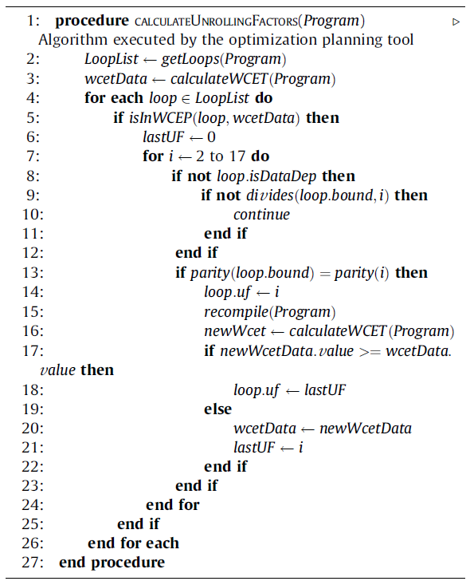
Unrolling Factor Selection
Combining loop unrolling strategies and code predication to reduce the worst-case execution time of real-time software
It is necessary to find the optimal Unrolling Factor for each loop that resides inside the WCEP
If it is in the WCEP, we test different Unrolling Factors, from 2 to 17
For Data-Independent loops the Unrolling Factor must exactly divide the execution count of the loop in order to avoid corner exit conditions
For Data-Dependent loops we consider Unrolling Factors whose parity is equal to the loop bounds’ parity
Then we recompile the program and test for WCET changes
Algorithm complexity is O($n^{2}$)
Better WCET with the cost of higher compilation time
13

Slide 18
Loop Unrolling-Code Predication
Authors’ Optimization Approach
Motivational Example
Evaluation & Results

Slide 19
Target Architecture
Combining loop unrolling strategies and code predication to reduce the worst-case execution time of real-time software
Supports a simplified complete Predication Support
32-bit Microprocessor with RISC Instructions
Direct-Mapped Cache Memory(32 blocks of 256 bits, thus 1024kB)
No Data-Cache
No out-of-order execution
Four issue, five stage static scheduled pipeline
14

Slide 20
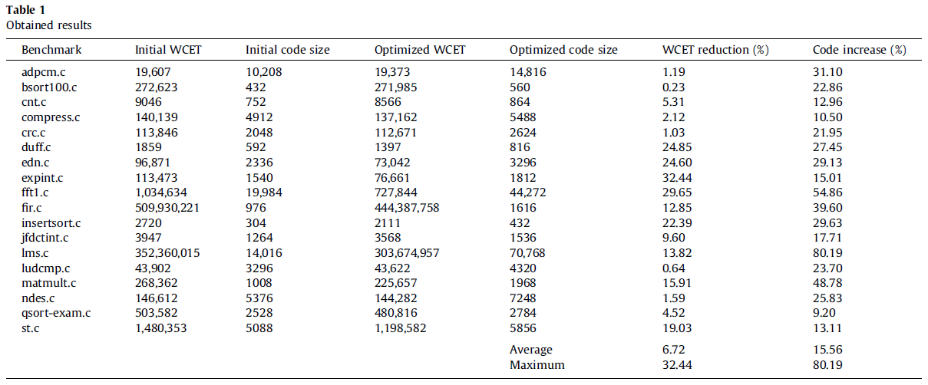
Results
Combining loop unrolling strategies and code predication to reduce the worst-case execution time of real-time software
$WCET Reduction=\frac{Initial WCET −Optimized WCET}{Initial WCET}∗100$
$Code Increase=\frac{Initial Code −Optimized Code}{Initial Code}∗100$
A total of 18 from 33 benchmarks are shown, since there was no gain in the other ones
We can see that the combination of techniques was able to reduce the WCET of half of the benchmarks
15

Slide 21

Thank you for your time!
Questions?

